Slide 1

Lending Club Case Study Presentation
Geeta Desai

Slide 2
Lending Club Case Study –Problem Statement
Lending loans to ‘risky’ applicants is the largest source of financial loss (called credit loss).
In other words, borrowers who default cause the largest amount of loss to the lenders.
We need to figure out the driving factors (or driver variables) behind loan default, i.e. the variables which are strong indicators of default. The company can utilize this knowledge for its portfolio and risk assessment.

Slide 3
Analytics Approach
Load Data
Univariate Analysis
Check Meta Data
Segmented
Univariate Analysis
Data Cleaning
Missing Values
Imputation
Outlier Detection/
Treatment
EDA
Bi-variate Analysis

Slide 4
Data Cleaning
Remove columns with more than 50% null.
Check and remove the columns which do not have an impact on EDA. The columns that do not have duplicates and are totally unique or all values are same these columns will not have impact on EDA and hence can be removed. This reduces columns from 111 to 36
Checking for rows with null. Only two rows have null columns and hence can be ignored
Checking for duplicate rows. There are no duplicate rows.
Standardize the columns like round off, conversion, etc
Impute columns where necessary like employee length column

Slide 5
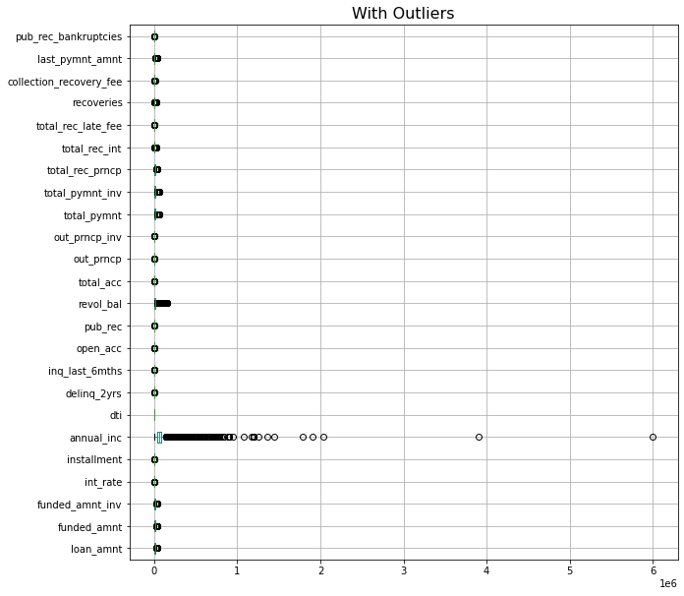
Outliers in Data
Box plot of continuous variables shows there are many columns with outliers

Slide 6
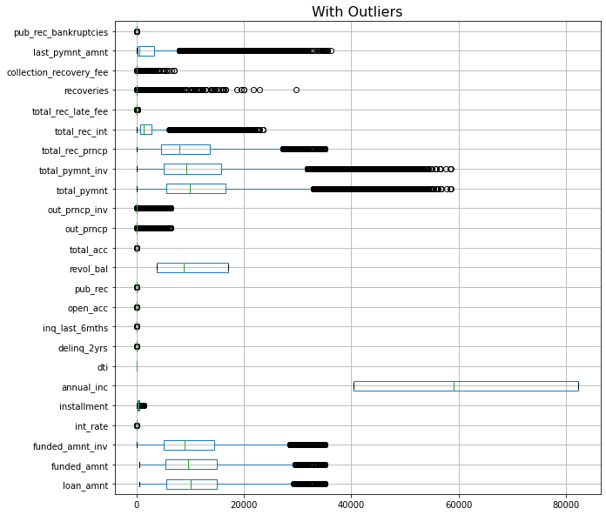
Outlier Handling
Check outliers with 0.25 and 0.75 quantile.
Remove outlier values if they are less than 50 %
If outlier values are more than 50%, treat them like imputing with lower range and upper range and box plot again. Now all required columns outliers are treated.

Slide 7
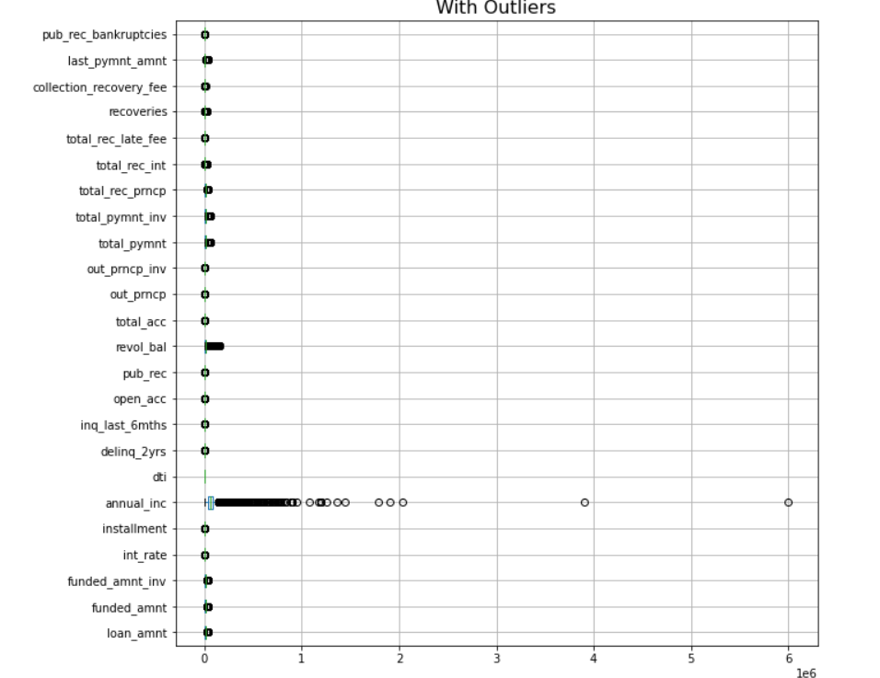
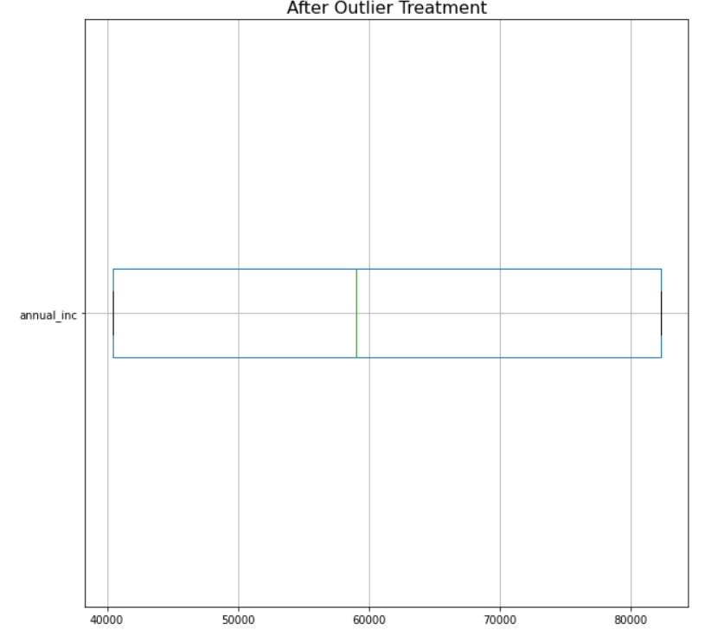
Outlier detection and treatment
Outliers are detected in multiple numerical variables- For example Annual_inc, these outliers were removed by replaced by restricting the value to the Upper range

Slide 8
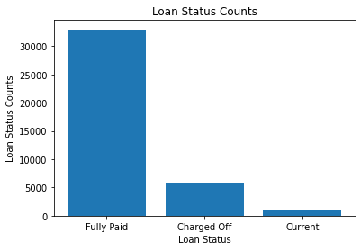
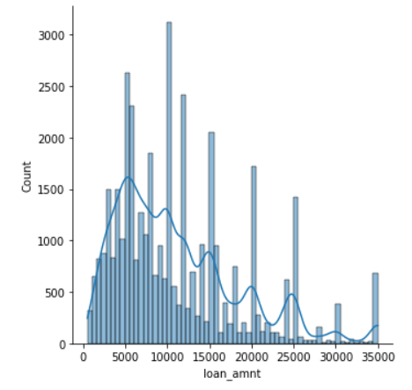
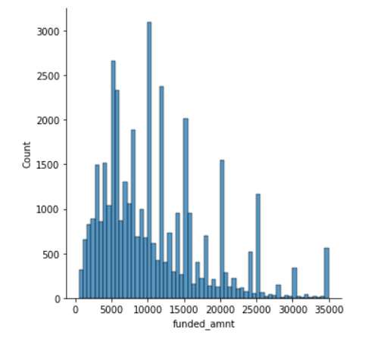
Univariate Analysis
Fully paid customers are approx. 6 times greater than Charged of customers
Histogram plots for loan amount and funded amount show that there are peaks at an interval of 5K . The patterns of count of loan amount and fund amount are exactly matching

Slide 9
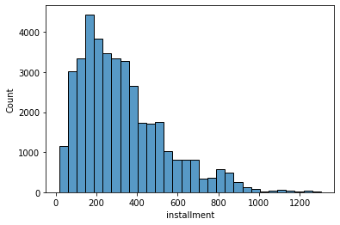
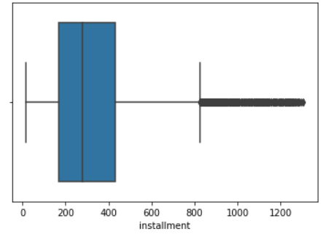
Univariate Analysis
Histogram plot for monthly payment owed by the borrowers (installment) is right-skewed with the most common installment amount of Approx 200.
The box plot shows that there are outliers on the higher range of the installment amount

Slide 10
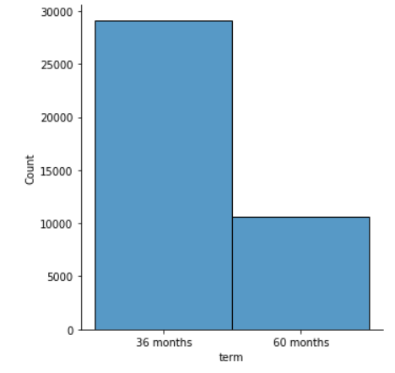
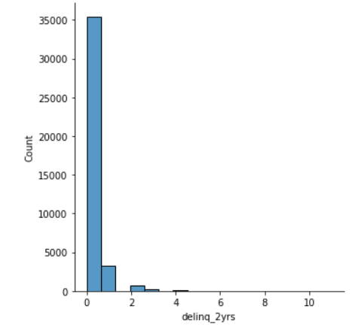
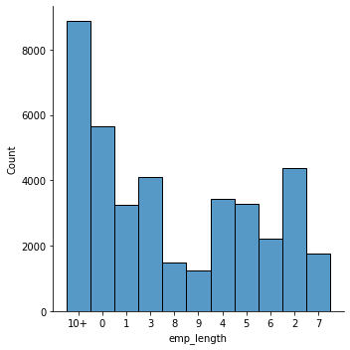
Univariate Analysis
No of customers who have taken a loan for 36 months duration are almost thrice those who have taken a loan for 60 months
Most of the customers are non-delinquent
Most of the customers have employee length greater than 10 years

Slide 11
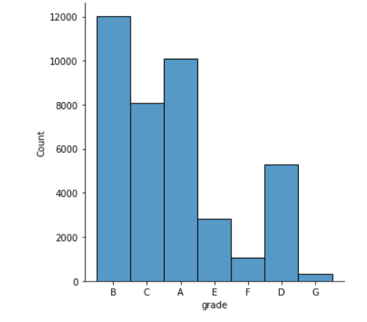
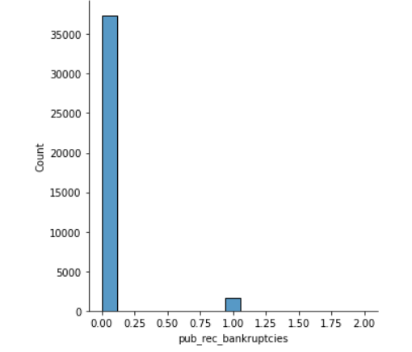
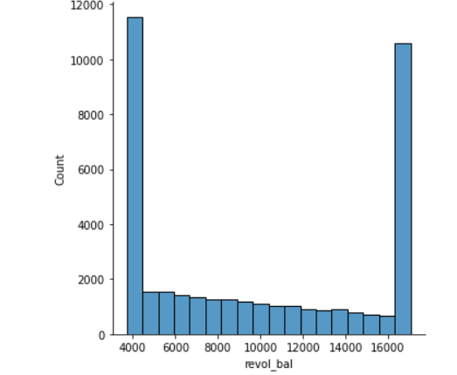
Univariate Analysis
Most of the customers are non-delinquent
Most of the customers have either higher or lower revolving balance
Most of the customers are A or B graded

Slide 12
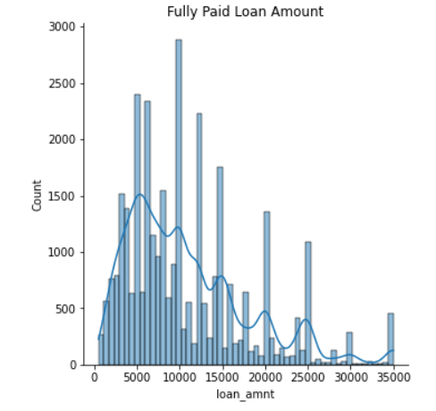
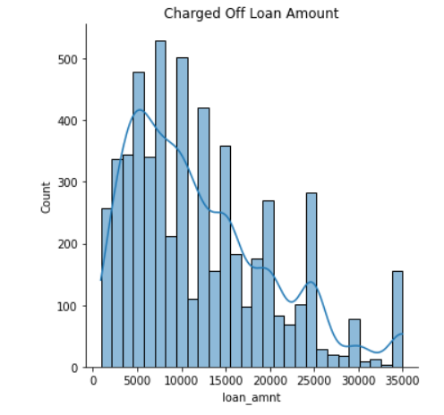
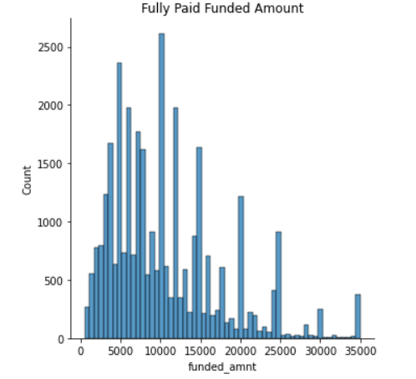
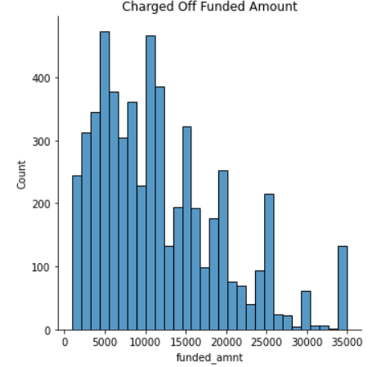
Segmented Univariate Analysis
Most of the customers are A or B graded
Most of the customers are A or B graded
Most of the customers are A or B graded
Most of the customers are A or B graded

Slide 13
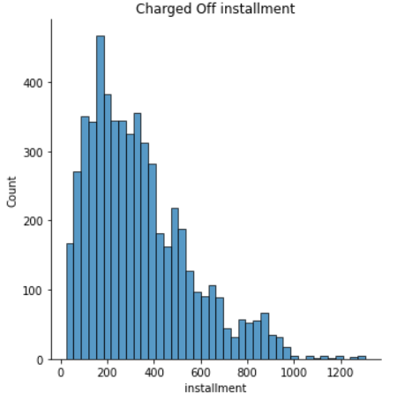
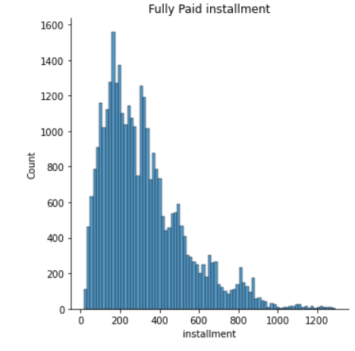
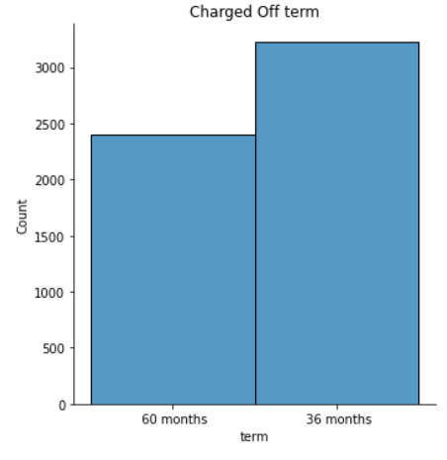
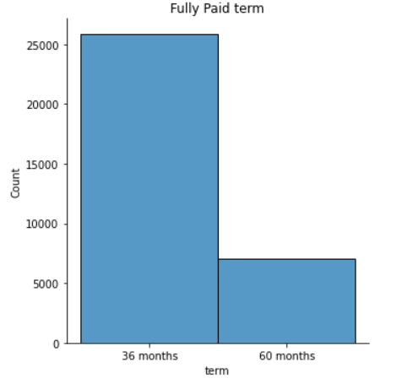
Segmented Univariate Analysis
Most of the customers are A or B graded
Most of the customers are A or B graded
Most of the Fully Paid loaners are pf 36 months tenure
May defaulters have 60 months tenure

Slide 14
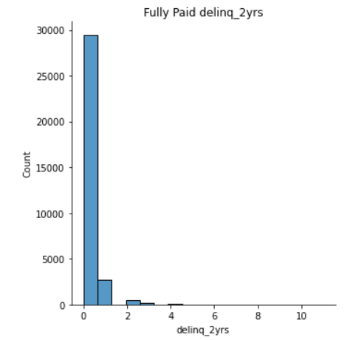
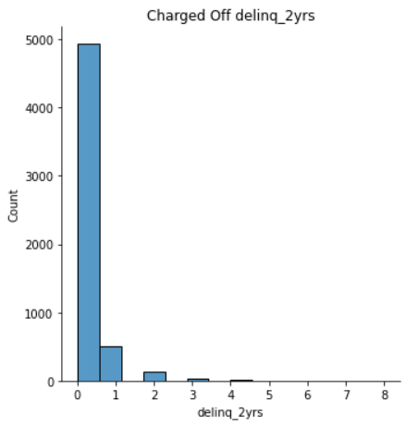
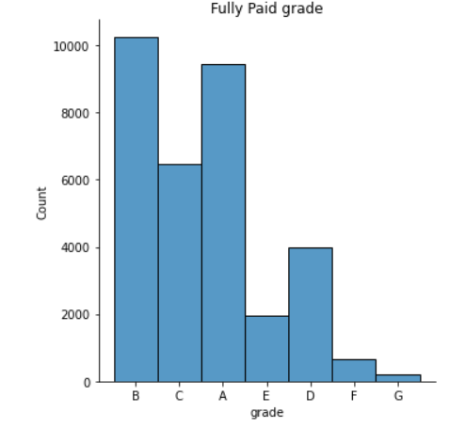
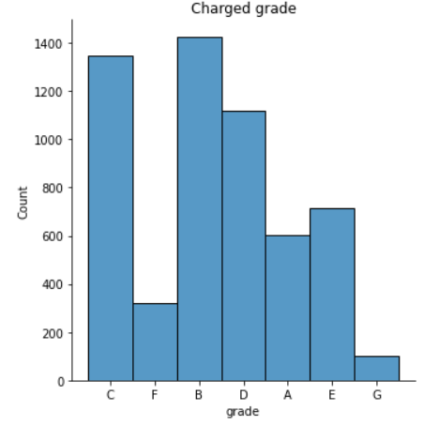
Segmented Univariate Analysis
Most of the customers have delinquency as 0
Most of the customers have delinquency as 0
Most of the customers are A or B graded
Most of the customers are A or B or D graded

Slide 15
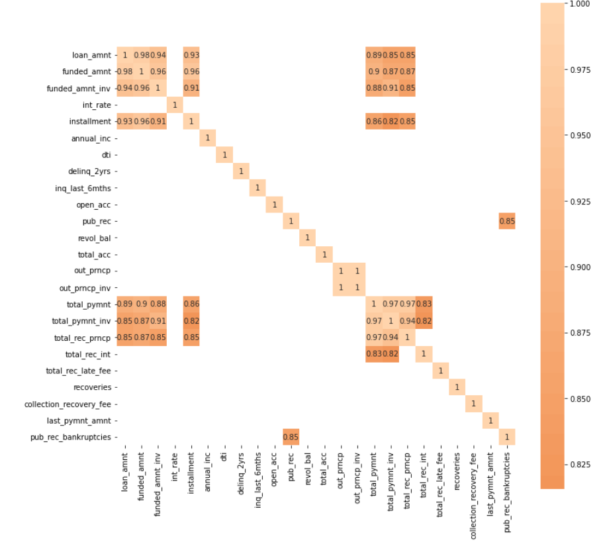
Bivariate / Multivariate Analysis
Variables that are highly correlated are …
Variables that are moderately correlated are…
Variables that are poorly correlated are…

Slide 16
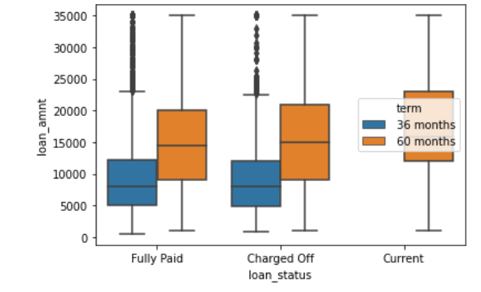
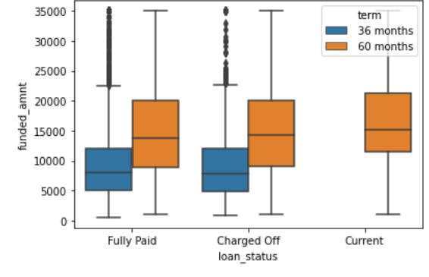
Bivariate analysis
Median for 60 months tenure is higher
Median for 60 months tenure is higher

Slide 17
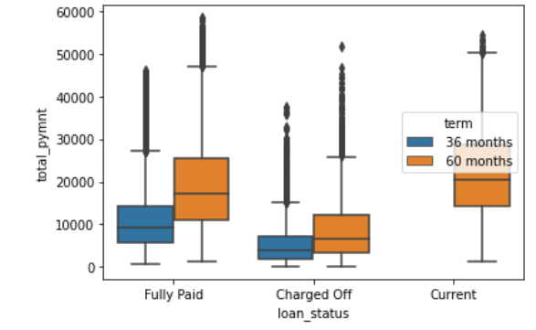
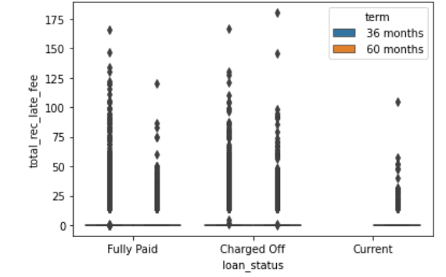
Bivariate Analysis
Charged off Customers have lower total payment median
Charged off customers have paid higher late fee for 60 months term

Slide 18
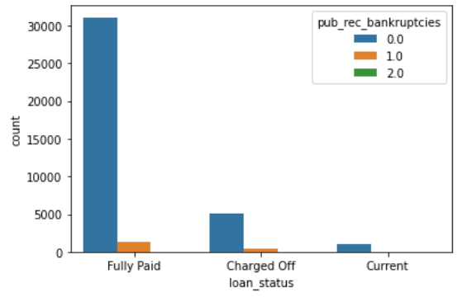
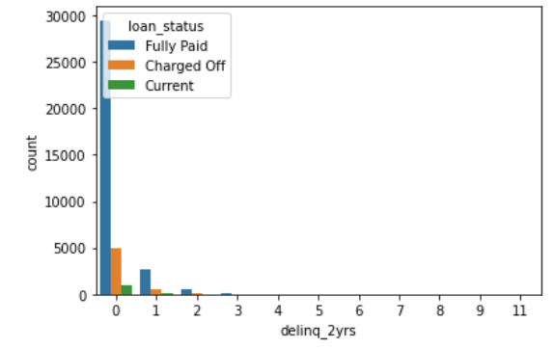
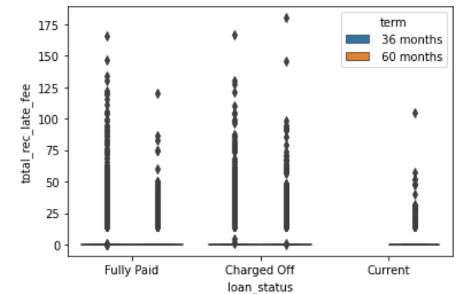
Bivariate Analysis
Charged off customers have higher bankruptcies
Less customers with delinquency
Charged off customers have more outliers in 60 months period

Slide 19
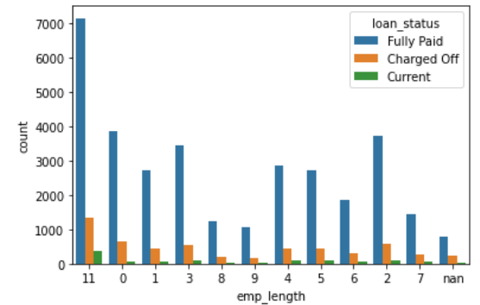
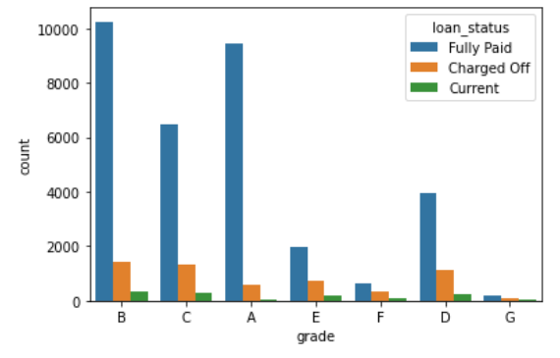
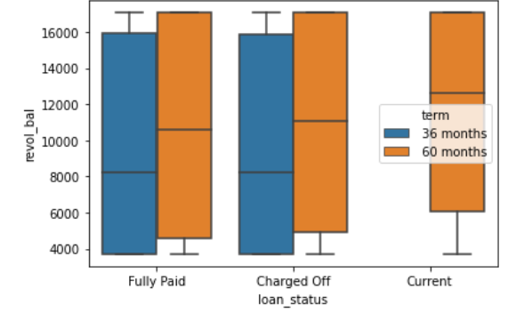
Bivariate Analysis
Employee Length is higher for Fully Paid customers
Most Fully Paid customers are having grade A or B Or D
Revolving Balance has similar median for Fully Paid and Charged off across 36/60 months tenure

Slide 20
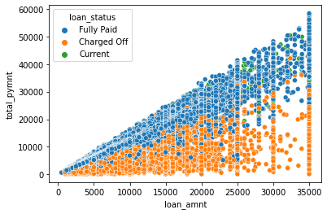
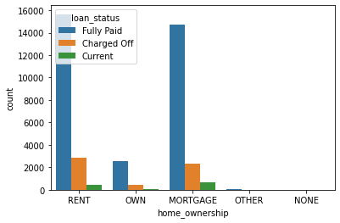
Bivariate Analysis
Defaulting Customers are having less total payments
Defaulting Customers have rented or mortgage home ownership

Slide 21
Final Analysis
Based on the above EDA performed the driving factors (or driver variables) behind loan default can be
Employee length
Installment
Total received late fee
Total payment
Home ownership

